Slide 1


Working together to create Web Performance Standards
Anderson Quach (Microsoft)
Tony Gentilcore (Google)

Slide 2
We’ll answer
What is the Web Performance Working Group?
Why is real-world measurement challenging?
What works today?
What’s next?
Working Group: http://www.w3.org/2010/webperf/

Slide 3
Measuring real-world performance

Slide 4
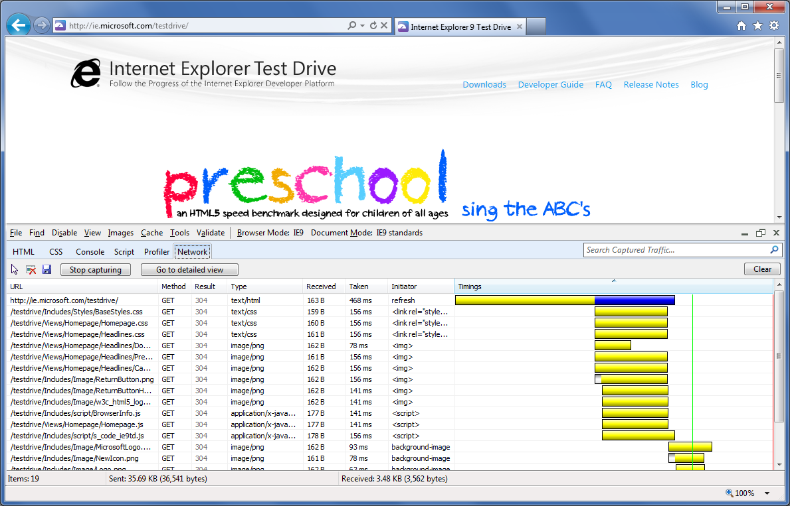
Measuring performance today
Standard way to measure latency across browsers
No way to measure network latency from JavaScript
Server-side measures lack complete picture

Slide 5






Web standards to measure performance
HTML document : Navigation Timing
Resources from HTML : Resource Timing
Interactive scenarios : User Timing
hyperlink

Slide 6

Challenges with providing performance information
Keeping end-users safe w.r.t. privacy and security
Efficient implementation in the browser
Useful information to assess and diagnose performance issues

Slide 7
Navigation Timing

Slide 8
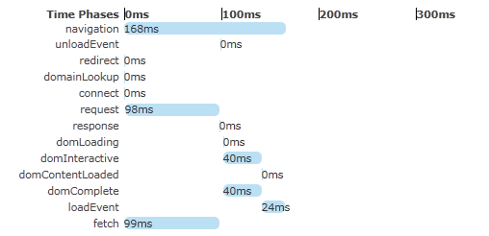
Navigation Timing
window.performance
navigation – describes the type of browsing and browsing activity
timing – the time taken to fetch and load the HTML document
window.performance.timing;
Specification: http://test.w3.org/webperf/specs/NavigationTiming/

Slide 9
What’s next?

Slide 10
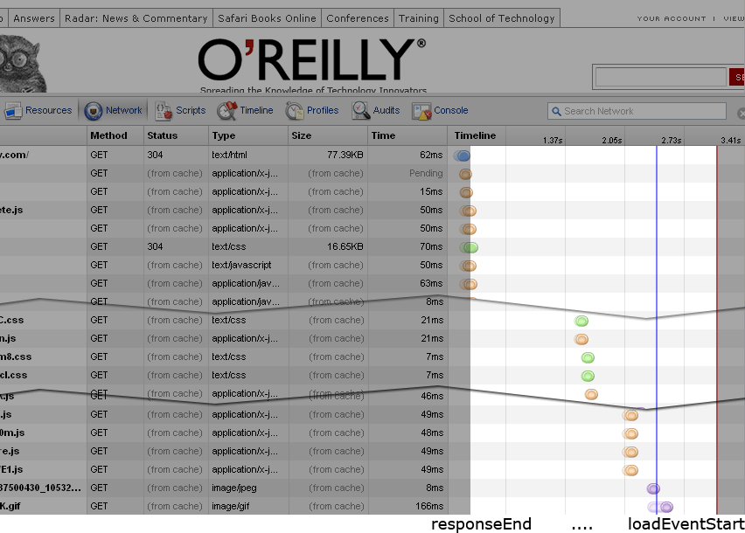
The Navigation Timing “gap”

Slide 11
Resource Timing: filling in the gap
Detailed timing for resources used by the page
redirectStart/End
fetchStart
domainLookupStart/End
connectStart/End
requestStart/End
responseStart/End
loadEventStart/End
Identify slow loading resources of any type
XHR, CSS, CSS Images, <script>, <img>, <object>,
<frame>, <iframe>, <embed>, <audio>, <video>
Specification: http://test.w3.org/webperf/specs/ResourceTiming/

Slide 12
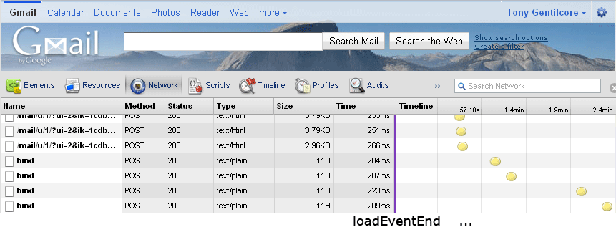
After the load

Slide 13
User Timing: timing interactive apps
Simple interface to high-precision timing
mark(“open_email”);
Standard location for analytics scripts and dev tools
getMarks();
> { open_email: 1299128230553
}
Specification: http://test.w3.org/webperf/specs/UserTiming/

Slide 14
Measure painting: a stretch goal
Give web apps better insight into when content appears on the screen
Allow web apps to determine frame rate for animations
Work within security and performance constraints

Slide 15
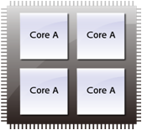
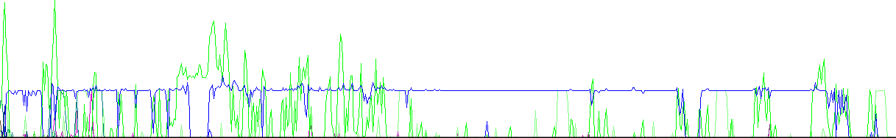
Spare the CPU

Slide 16
Visibility, Yielding, Painting
Allow web app to know if it is in the background so it can be more efficient
  Poll less frequently
  Pause animations
  Stop updates
Allow true zero-duration yields
Avoid animating faster than paints can keep up

Slide 17
Q & A
mailto: public-web-perf@w3.org

Slide 18
Resources
Download and try it out
  Latest version of Microsoft IE9 www.microsoft.com/ie9
  Latest Google Chrome Beta http://www.google.com/landing/chrome/beta/
Demos
  http://ie.microsoft.com/testdrive/Performance/msPerformance/Default.html
  http://webtimingdemo.appspot.com/
W3C resources
  Working Group http://www.w3.org/2010/webperf/
  Navigation Timing http://test.w3.org/webperf/specs/NavigationTiming/
  Resource Timing http://test.w3.org/webperf/specs/ResourceTiming/
  User Timing http://test.w3.org/webperf/specs/UserTiming/

